Slide 1

Being Proactive:
Wearing a Mask is Essential
Sand hills GNETS Corner
Presented by: Quenshauna Motley Smith, Ed. D.
GNETS Liaison

Slide 2

GNETS Mission Statement
Teach students the values and skills they need to live a successful life filled with a sense of belonging, a love for learning, and compassion for others.

Slide 3
GNETS Vision Statement
Our Vision is to see students learn or rediscover skills that will help them to benefit from academic instruction in the least restrictive school environment available to them. Learning to use words to communicate ideas and feelings and discovering the value of being a group member enhances a student's ability to achieve. By working cooperatively with our students, their parents, local school personnel, and other community agencies our students will become lifelong learners and productive citizens.

Slide 4

Considerations for Wearing Masks
Center for Disease Control (CDC) recommends that people wear masks in public settings and when around people who don’t live in your household, especially when other social distancing measures are difficult to maintain.
Masks may help prevent people who have COVID-19 from spreading the virus to others.

Slide 5
Considerations for Wearing Masks
Masks are most likely to reduce the spread of COVID-19 when they are widely used by people in public settings.
Masks should NOT be worn by children under the age of 2 or anyone who has trouble breathing, is unconscious, incapacitated, or otherwise unable to remove the mask without assistance.

Slide 6
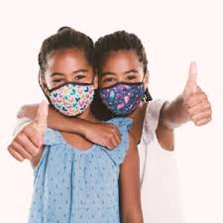
Learning Intentions
To continue to promote a safe and healthy environment for students as outlined with district and CDC policies and best practices.
To encourage students to wear masks during the school day by implementing strategies that encourage the wearing of masks.

Slide 7

Effectiveness of Wearing Masks
Masks are recommended as a simple barrier to help prevent respiratory droplets from traveling into the air and onto other people when the person wearing the mask coughs, sneezes, talks, or raises their voice. This is called source control.

Slide 8
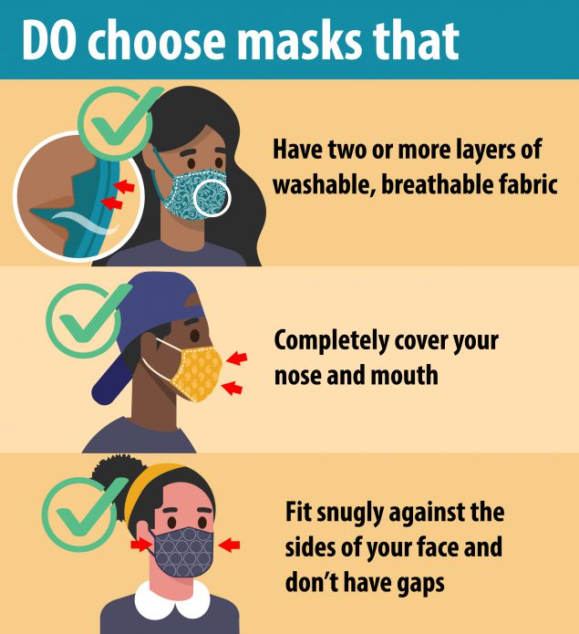
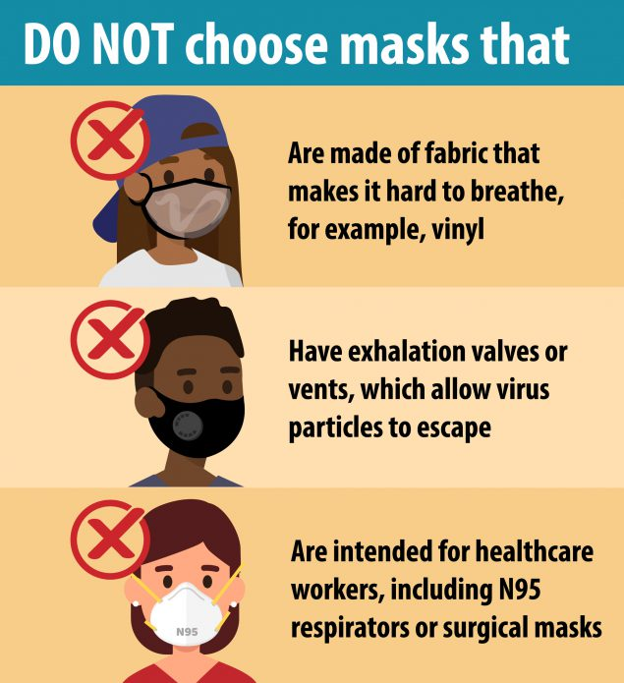
When Selecting a Mask….

Slide 9
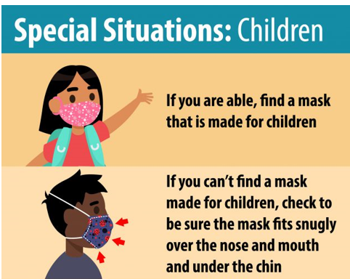
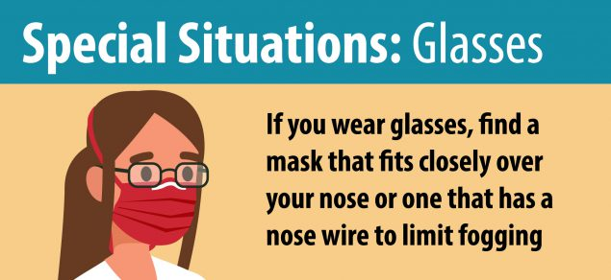
When Selecting a Mask
Keep In Mind….

Slide 10
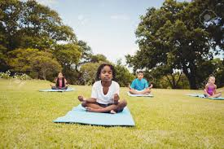
STRATEGIES FOR students Wearing MASKS
Tip #1
Calming bag: Tangible items such as Band-Aids, mints, a personal note or encouraging sticker, extra pencils, etc. can often feel comforting when someone notices our fears or worries.
Teachers can create a bag for each student—if a grant or other funding is available—
Send home a list of items so that parents and guardians can create the bags.

Slide 11
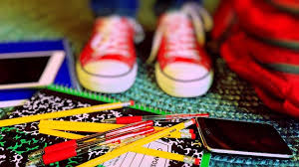
STRATEGIES FOR students Wearing MASKS
Tip #2
New routines: be purposeful about creating classroom routines to ease any embarrassment, discomfort, worry, or anxiety students may have about wearing masks.
Many of our students will not walk in already accustomed to wearing masks, so routines and predictable structures can help them feel calm and ready to learn.
Routines can include things like drawing or journaling thoughts or other hands on activities.

Slide 12

STRATEGIES FOR students Wearing MASKS
Tip #3
Connections with parents: A letter to parents outlining class procedures and routines will ease their anxiety and that of their kids. Teachers can also use this letter to invite parents to share the celebrations and challenges their children have experienced over the past several months.

Slide 13

Suggested Questions to Ask Parents
What are the two or three best ways I can create a positive experience for your child this year?
Please share your favorite memories of your child. What makes him or her smile and laugh?
What do you need from me that would be helpful for your family?
What are ways I could help your child adjust to the mask this year?

Slide 14
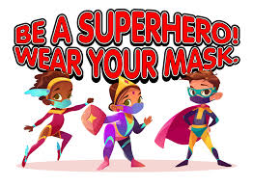
STRATEGIES FOR students wearing MASKS
Tip #4
Face masks and superhero powers: This is a new focused attention practice designed around masks.
Ask students what superhero they are, ask them all to create a power pose. As they hold this pose, have them breathe in three deep breaths, hold for a couple of seconds, and then breathe out a superpower they wish to send to themselves, someone they care about, or the world.

Slide 15

STRATEGIES FOR students Wearing MASKS
Tip #5
Morning meeting questions: These are some questions teachers can use so that students can get use to wearing their masks.
How does a mask protect us?
Do you know of any superheroes that wear masks?
Maybe we could all decorate our own paper masks? What colors, shapes, and designs do you want on your mask?

Slide 16

STRATEGIES FOR students Wearing MASKS
Tip #6
Emotion reading practice: We are capable of reading facial expressions from the eyes up.
Teachers can spend a few minutes a day practicing this. Have a student wearing a mask think of a feeling and try to express that with their face, ask the class to guess the emotion or feeling.
Another option is to put little masks on the emojis on feeling charts. Students can work to become experts at reading facial expressions of people wearing masks, which could be a fun ritual that reduces anxiety and fear.

Slide 17
References
https://www.edutopia.org/article/how-help-students-get-used-masks
https://www.cdc.gov/coronavirus/2019-ncov/prevent-getting-sick/cloth-face-cover-guidance.html
https://www.rcboe.org/sandhills

